Slide 1
Accountability and MBCPs
Noelene Iannello
Michael Sheehan
Relationships Australia WA

Slide 2
Basic Assumptions
Living free of violence is a human right enjoyed by all
Individual is personally responsible for behaviour towards others

Slide 3
Human Right: Violence-free
Women have the right to make choices on an equal basis with men
Convention on the Elimination of all Forms of Discrimination Against Women (UN 1979)
Right to free moment (article 15)
Right to work and free choice of employment (Article 11)
Equality in management of family resources (Article 16)
Governments to embed the principle of equality in national constitutions, legal codes, laws (Article 2)

Slide 4
Personal choice and responsibility
Each individual is responsible for his/her behaviour towards others
We have choices and alternatives
Use of abusive behaviours involves a choice to use them over other, non-violent and more respectful behaviours

Slide 5
Accountability
Grounded upon:
The safety, well-being, human rights of women and children
Placing women’s and children’s needs and voices at the centre
Include women/children in the process and progress of interventions – as they experience the consequences of successful or unsuccessful intervention

Slide 6
Accountability
Is the ability to recognise, end and take responsibility for violence
We usually think of the person doing harm as the one to be accountable for violence
Society and communities must also recognise, end and take responsibility for violence by:
becoming more knowledgeable and skilful
willing to take action to intervene
supporting social norms and conditions that prevent violence from happening in the first place

Slide 7
Whose responsibility?
Perpetrator – the person using the violence
Service providers
Hospitals
Churches
Community
Criminal justice system
Police
Judiciary
Government

Slide 8
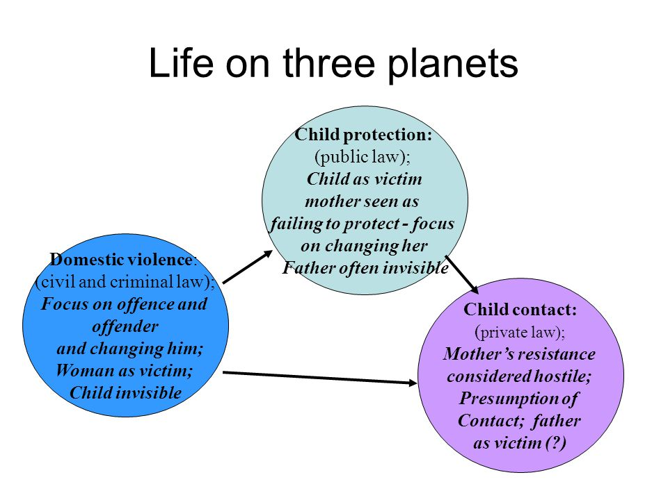
Marianne Hester, The British Journal of Social Work, Volume 41, Issue 5, 1 July 2011, Pages 837–853

Slide 9
Accountability
A strong integrated family and domestic violence (FDV) service system involving:
Whole-of-government leadership and approach
Shared understanding of FDV among systems/agencies
Co-ordinated community responses to risk assessment and risk management
Information and data sharing

Slide 10
Integrated FDV system
Assesses risk, undertakes safety planning and creates service plans
Monitors and manages risk on an ongoing basis through co-ordinated community responses
Shares relevant information with women’s and children’s services, child protection, police, courts etc. involved in supporting women’s/children’s safety and well-being

Slide 11
Integrated FDV system: Perpetrators
Identifies those men who choose to use FDV
Effectively engages men ASAP following identification (Police orders, Intervention orders)
Refers men to appropriate services
Applies sanctions to motivate or mandate men to participate in services
Responds swiftly to new offences and technical violations of conditions (FVROs, re-appearance at court).

Slide 12
Integrated FDV system: Victims
Respects and listens to those affected by violence by:
Acknowledging the violence and its impact
Being clear that the one who perpetrates abuse is the one who is responsible
Honouring women’s resistance to the violence
Challenging victim-blaming messages women have received from others
Supporting women to be safe and to make their own decisions/choices

Slide 13
Accountability fails when
Men are not identified (e.g., health, human and community services, AOD, mental health)
Services lack resources/procedures to engage men effectively following identification
Men can’t commence, or lose interest in, a MBCP due to long wait times
The voices and safety of women and children are not at the centre
Contradictory and uncoordinated service responses

Slide 14
Engaging men: Principles and practices
Stay within the limits of your role – refer to specialist men’s FDV services
Victim safety and confidentiality is paramount
Interview perpetrators alone; interview partners and children separately
Do not disclose information provided by partners or children to perpetrators

Slide 15
Engaging men: Principles and practices
Keep the conversation on the man’s responsibility for his use of violence
Focus on his common desire to do what's in the best interests children
Be cautious about signs of remorse and in interpreting men’s progress

Slide 16
Accountability of men as fathers
Overlap between FDV and child abuse well-documented
Harmful impact of men’s use of FDV on children even when children are not directly targeted
Includes men’s attempts to sabotage their partner’s parenting, interfere with her role as a mother and disrupt the mother-child bond.
Remedy mother-blaming and hold fathers accountable

Slide 17
MBCPs: Measures of change
The key is not the completion of programs, but:
victim safety
behaviour change

Slide 18
Process of change:
Full disclosure of:
Pattern of coercive control
Abusive attitudes and behaviours
Acquires respectful behaviours
Accepts responsibility and consequences of actions
Develops empathy: Acknowledges impact of abuse/violence
Gives up excuses
Makes amends

Slide 19
Group vs counselling
Group’s social environment:
Modelling of male and female co-facilitators
Peer feedback for change
Reduce shame: through supportive environment that supports honest appraisal of actions
Partner contact and monitoring of risk
Caveats:
Counselling: responsibility and impact for abusive behaviour not addressed
Couple counselling: mutuality
Anger management: “I abuse not because I’m angry; I’m angry because I’m abusive”

Slide 20
Conclusion: Accountability
A shared understanding of FDV amongst systems and agencies, including a common risk assessment framework
Placing women and children at the centre - support their efforts towards safety, dignity and perpetrator accountability through civil and criminal justice systems
Co-ordinating community responses to risk assessment and risk management
MBCPs work best in this context of monitoring, consequences and co-ordination

Slide 21
"It is not only what we do, but also what we do not do, for which we are accountable."
Moliere

Slide 22
Accountability: Placing women’s and children’s needs and voices at the centre
Accountability in the context of MBCPs
Dependent on what we consider to be the fundamental aim of MBCP work
Assumption that the fundamental aim is changing the behaviour of men who choose to use violent, coercive and controlling behaviour
But…
Fundamental aim of MBCPs is working towards the safety, wellbeing, human rights, and dignity of women and children affected by men’s use of violent, coercive and controlling behaviour
Notes:
‘Accountability to women and children’, ‘holding perpetrators accountable’ and ‘perpetrator accountability’ are all terms that are often used in family and domestic violence policy documentation. But what do these terms mean in the context of Men’s Behaviour Change programs themselves?
What we understand ‘accountability’ to be in the context of Men’s Behaviour Change programs, is dependent on how we ‘define’ what the fundamental aim or outcome of Men’s Behaviour Change programs are.
Given the name ‘Men’s Behaviour Change Program’ – the assumption is that the primary outcome for these programs is ‘men’s behaviour change’ – often equated with the cessation of physical violence, and often evaluated in terms of completion rates (did a particular man complete a particular MBCP), and by other police and justice recidivist focussed data - such as police call outs and re-entry into the justice system through further offending. Program success of is then determined solely on changing men’s behaviour. ‘Men’s’ behaviour change is at the centre.
Of course men's behaviour change – concerned with the cessation of physical violence, supporting men to take responsibility for his violent and controlling behaviour, helping men identify existing and previous strategies that have been useful in choosing non-violence etc - is a an important strategy in working towards the safety and wellbeing of women and children, but it is not the only important objective. Achieving immediate and long-term behavioural change is not the fundamental aim of MBCP work in and of itself.
Instead, men’s behaviour change is one of a number of important objectives that support working towards the fundamental aim of the safety, wellbeing, human rights and dignity of women and children.
While the welfare, dignity and wellbeing of men engaging in MBCPs is important, and while there are real benefits to men from the work they do in MBCPs in terms of developing respectful and non-violent partnerships with women and children, MBCP work can be seen as primarily about the safety, wellbeing and dignity of women and children.

Slide 23
Accountability: Placing women’s and children’s needs and voices at the centre
Behaviour change is an important objective for MBCPs, but other objectives are equally important:
Supporting/enhancing women’s and children’s safety, wellbeing and agency directly through partner support work, and through associated services for children
Assisting with multi-agency risk assessment and risk management (MACM) processes, particularly in cases where women and children are considered to be at high risk
Notes:
While behaviour change is an important objective of MBCPs, other objectives are equally important for achieving the fundamental aim of working towards the safety and wellbeing of women and children.
These other, equally important objectives include:
Supporting/enhancing women’s and children’s safety and agency directly through partner support work, and through associated services for children.
Partner support is central to the work of MBCPs. I will expand on partner support in the context of MBCP work a little later, and look at its central place as accountability practice in MBCPs.
Assisting with multi-agency risk assessment and risk management (MACM) processes, particularly in cases where women and children are considered to be at high risk

Slide 24
Accountability: Placing women’s and children’s needs and voices at the centre
Making and keeping men using violent, coercive and controlling behaviours visible to the broader accountability system by increasing scrutiny and monitoring of the man’s behaviour and any changes in risk for women and children
Supporting formal accountability processes – civil, criminal, statutory - by reporting breaches of protection orders, violence related crimes and by working with child protection when there is risk of harm to children from the man’s violence towards the children’s mother and/or to the children themselves
Notes:
Making and keeping men using violent, coercive and controlling behaviours visible to the broader accountability system by increasing scrutiny and monitoring of the man’s behaviour and any changes in risk
Supporting formal accountability processes – civil, criminal, statutory - by reporting breaches of protection orders, violence related crimes and by working with child protection when there is risk of harm to children from the man’s violence towards the children’s mother and/or to the children themselves
Just to note – that working with child protection services would be within the context of ‘safe and together’ - keeping children safe and together with the non-offending parent, most usually the mother, and supporting the man where possible to be a safer parent. Thus alleviating the burden of responsibility from women to keep their children safe from violent men as fathers, and moving away from the ‘failure to protect’ paradigm that has been dominant in child protection work (not just in WA, but nationally and internationally) where family and domestic violence has been identified.

Slide 25
Accountability: Placing women’s and children’s needs and voices at the centre
Placing equal importance on this range of objectives starts to centre the needs of women and children
Placing women’s and children’s safety, wellbeing, human rights and dignity at the centre of MBCPs has important implications for measures of ‘success’
‘Success’ means more than just ending the violence
Notes:
Emphasising a range of important objectives for MBCP, other than just men’s behaviour change, starts to place women and children’s needs and voices at the centre of MBC work.
Placing women’s and children’s safety, wellbeing, human rights and dignity as the centre of MBCPs then has important implications for how we understand and measure the ‘success’ of MBCPs.
That is , we can no longer just be concerned with what is often a ‘law and order’ measure of ‘success’ – primarily recidivism – but should now be concerned with potentially a more nuanced and sophisticated understanding of what ‘success’ means – one that positions MBCP as ‘allies’ in women’s and children’s struggles towards safety , wellbeing, human rights and dignity.
Measuring ‘success’ through the single lens of ‘men’s behaviour change’ makes invisible all of the other important ways that MBCPs promote and support the safety of women and children, and contribute to and strengthen perpetrator accountability, and provides an often incomplete picture of the value of MBCPs.

Slide 26
Accountability: Placing women’s and children’s needs and voices at the centre
In decreasing order, women defined ‘success’ as:
Respectful/improved relationships
Expanded space for action
Support/decreased isolation
Enhanced parenting
Reduction or cessation of violence and abuse
The man understanding the impact of family and domestic violence
Notes:
A large multi-site study in the UK (Project Mirabel) has found that ‘success’ of MBCPs was defined by women as:
Respectful/improved relationships
Expanded space for action
Support/decreased isolation
Enhanced parenting
Reduction or cessation of violence and abuse
The man understanding the impact of family and domestic violence
Notably, the reduction or cessation of physical violence was mentioned less frequently than four other themes. While the cessation of physical violence is an important outcome of MBCPs, women wanted more than just the physical violence to stop. The study proposed that a more nuanced understanding of MBCP ‘success’ is required, one which takes account of the more subtle, life enhancing changes for women and children.

Slide 27
Placing women’s and children’s needs and voices at the centre of MBCPs: Partner support
Partner support work is seen as an essential component of MBCPs
Partner support is embedded in practice standards for MBCPs
‘Partner support’ does not reflect the often intense, high risk and ongoing nature of the work associated with women (and their children) whose male partner is attending an MBCP
Notes:
Partner support is an essential component of MBCPs – not only as a way of working towards the safety, wellbeing , human rights and dignity of women and children, but particularly given the possibility that MBCPs can create increased risk for women and children by virtue of a man’s actual participation in a program. That is, there are ‘side effects’ to MBCPs – they can provide new skills which can be used in the wrong way; they can introduce the man using the violence to new forms of abusive, coercive and controlling behaviour; they can unrealistically increase women’s expectations of change; and they may lull women into a false sense of security that has no basis – compromising their safety and that of heir children; and the man may use his participation in the MBCP to further control his partner.
Partner support work is embedded in practice standards for men's behaviour change work.
The term ‘partner support’ does not reflect the often intense, high risk and ongoing nature of the work associated with women (and their children) whose male partner or former partner is attending an MBCP. The work is more than ‘support’ - and can often take, or has the ability to take, up significant resources for agencies and organisations providing MBCPs – particularly in cases of high risk.

Slide 28
Placing women’s and children’s needs and voices at the centre of MBCPs: Partner support
Seeing women in their own right
Noticing and validating women’s agency and resistance
Patiently engaging, building trust, hearing women’s stories and narratives
Risk assessment and risk management
Safety planning
Preparing women for their male partner’s participation in an MBCP
Notes:
Although the form, breadth and depth of partner support work can (an often does) vary across MBCPs – at least some or all of the following are present in the work:
Seeing women in their own right – not just as a man’s partner or former partner , or as a parent
Noticing and validating women’s agency and resistance
Patiently engaging , building trust, hearing women’s stories and narratives
Risk assessment and risk management
Safety planning
Preparing women for their male partner’s participation in an MBCP

Slide 29
Placing women’s and children’s needs and voices at the centre of MBCPs: Partner support
Giving clear messages to women about family and domestic violence
Directly providing support, advocacy and referrals
Understanding and realistically engaging with women’s hopes and expectations of MBCPs
Assisting with risk assessment and risk management regarding any children
Obtaining information on men’s ongoing behaviour and holding them accountable for this
Notes:
Giving clear messages to women about family and domestic violence and the work that is done in MBCPs – to counter the misinformation that they might be, and often are, receiving from their male partners or former partners attending MBCPs.
Directly providing practical support, advocacy and referrals, and possibly counselling
Understanding and realistically engaging with women’s hopes and expectations of MBCPs – including the limitations of MBCPs and the very real possibility that the violence and coercive and controlling behaviour may not stop.
Assisting with risk assessment and risk management regarding any children, and as one avenue to strengthen the mother-child bond that is often deliberately targeted and sabotaged by men using family and domestic violence.
Obtaining information on men’s ongoing behaviour and holding them accountable for this – through formal accountability processes where appropriate and where women deem this safe for themselves and their children

Slide 30
Placing women’s and children’s needs and voices at the centre of MBCPs: Partner support
Partner support is initiated upon a man’s assessment for an MBCP
Primarily by telephone, at least initially
Not all partners are able to be contacted
Not all partners want support (from the MBCP provider)
Support can be long-term
Notes:
Partner support commences as soon as a man has been assessed for inclusion in a MBCP. As part of the assessment and inclusion process for an MBCP, men must provide the contact details of former and current partners (as well as children) who have been subjected to his violence.
While partner support may initially be by telephone – any subsequent support may be via face to face sessions, which may be one-off, or occur on a regular, continuing basis; support may also occur through the provision of partner support evenings/meetings; or through a women’s (and children’s) specialist family and domestic violence support group for women.
Not all partner’s of men assessed for MBCPs are able to be contacted, and not all partner’s who are able to be contacted wish to take up the offer of further partner support.
Partner support can continue long term- well after a man has completed a MBCP, and does not cease if a man discontinues a MBCP – given that this often a time of increased risk for women and children

