Slide 1
Engaging Aboriginal Men in MBCP
Outcare

Slide 2
Acknowledgement
We would like to acknowledge the Wadjuk people from the Noongar nation who are the traditional owners of this land on which we are meeting today. We would also like to acknowledge the traditional custodians of this land, the Noongar people, and pay my respects to their Elders past, present and emerging, for they hold the memories, traditions, the culture and hopes of Aboriginal Australia
Notes:
Joslyn

Slide 3
Introduction
Our team will provide you with invaluable insights and context on what is currently working with our FDV Program in ‘Engaging Aboriginal Men in MBCP’s’…
Our FDV Program team consists: of Case managers: Mary Lynch, Lennon Marlin, Nina Aramoana; Counsellor: Tucker Christou and Peer Worker: Max Kelly.
Leadership learnings include:
Cultural Integrity
Cultural Responsibility
Cultural Capacity Building
Cultural Responsive Recruitment strategy
Notes:
Joslyn

Slide 4
Statistics
Aboriginal and Torres Strait Islander people make up over 2.8% of Australia's population
Aboriginal people currently make up 30% on Nationwide prison population
More than 500,000 Australians still living have been to prison
More than 100,000 First Nations people contribute to this statistic
1 in 7 First nations people have experienced prison (Source- Gerry Georgatos)
Acacia Prison
- Total detainee population; 1526
- First Nations detainee population; 463
Notes:
Lennon to present

Slide 5
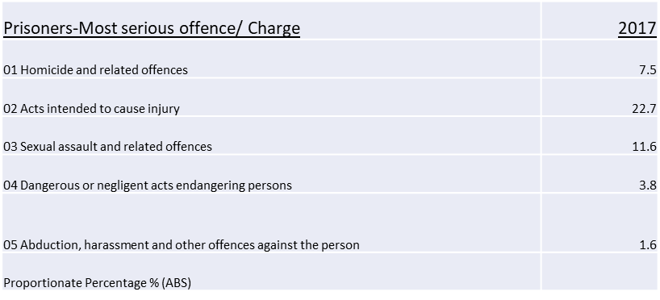
Statistics
Notes:
Lennon to present

Slide 6
Synopsis of Program
The primary aims of this program are to increase the safety of victims and children
A Voluntary MBCP designed to work specifically with Aboriginal men
We have had 49 Aboriginal men deemed suitable and engaged in the program since March 2017
Connecting him to his capacity and skills for living a safe and abuse free life
A Psycho Educational group setting
Each session provides an opportunity to learn how the abuse pattern started, ways that thought patterns fuel the need to control others, the internal ‘permissions’ that allows abuse
Notes:
Tucker

Slide 7
Synopsis of Program
Every session teaches him to listen, observe, share stories, learn and be safely and respectfully challenged.
He is invited into opportunities to listen to others talking through experiences which can enable a deeper understanding:
Of the abuse dynamic
What has brought him to make these choices
Importantly, strategies for change building a ‘toolkit’ of skills
Unique to this program is the connection to mind, body and spirit
Notes:
Tucker

Slide 8
Whole Body Engagement
Cultural Capability NOT Cultural Competence, through Acknowledgment, Empathy, Understanding and Passion
Knowledge of Family Violence
Understanding of aboriginal specific links to Family Violence
Female Perspective
Non-Judgement of the life path and recognition of the past
Dignity and Worth
Separating the behaviour from the person
Build Rapport through Active Listening
Person Centred – “He is the expert on himself”
Disclosure of trauma
Head
Eyes
Ears
Notes:
Mary and Nina

Slide 9
Whole Body Engagement
Mouth
Respectfully Challenge
Continuous Reinforcement
Real Life Practical Examples – Using Aboriginal English
Understanding of Hand Gestures
Practical Support
Empathy
Spiritual Awareness
Walking with these men on their individual journey’s
Supportive
Hands
Heart
Feet
Notes:
Mary and Nina

Slide 10
Whole Body Engagement
Notes:
Mary and Nina

Slide 11
Counselling Component
Initially as part of the group work there was six one to one counselling sessions with a qualified counsellor skilled in working with Family Domestic Violence. This has now changed due to the counselling sessions identifying such high levels of:
Childhood abuse
Intergenerational trauma
Drugs and alcohol abuse
Cultural vouching
Aboriginal male co-facilitator
To build respect & trust, but never taking this for granted
It’s not a black thing but a human thing

Slide 12
In Closing
MBCP’s are instrumental in working with Aboriginal men. The programs allows challenging learning and growth experiences to assist them to become empowered men.
To date our FDV program has demonstrated a shift in healing and empowerment journey with those who make a renewed commitment to keeping their women and children safe.
Additionally, the base line statistics that case manager: Lennon has reflected on with the over representation of Aboriginal men are damning.
MBCP’s going forward:
Cultural Respect
Successful Engagement and Responding to Challenges
MBCP’s maintain partnerships
Cultural Confidence
Notes:
Joslyn to name them and if questions for each person to answer

Slide 13
Questions & Answers
Notes:
Joslyn to name them and if questions for each person to answer

