Slide 1
Perpetrator Pathways
Galvanising Perpetrator Response Across a Complex Sector

Slide 2
ANROWS Research Project
Improving safety through better engagement and retention of perpetrators across the systems of interventions
Curtin University led, national project to inform the processes required to shift system focus onto the perpetrators of family and domestic violence, and alleviate the burden placed on women and children.
Traditionally, the responsibility of the protection and safety of victims of domestic, family and sexual violence has been placed upon the victim.
A concerted effort to place a greater system focus on the perpetrator.
The project will inform the processes which are required for shifts in system orientation to be established.

Slide 3
Research Aim
Provide a comprehensive analysis of research in integrated systems and interventions for perpetrators, and undertake service mapping of current domestic and family violence and sexual violence responses incorporating interventions across the continuum of responses from primary prevention to tertiary interventions; and
Examine how the tracking, engagement and retention of perpetrators within Systems of Perpetrator Interventions (SIPs) can be enhanced.

Slide 4
The Research Team
Professor Donna Chung, Associate Professor Reinie Cordier, Mr Damian Green, Professor Siobhan Austin (Curtin University)
Ms Elena Campbell (RMIT)
Professor Jan Breckenridge (UNSW)
Dr Michael Salter (University of Western Sydney)
Professor Patrick O’Leary (Griffith University)
Mr Rodney Vlais.

Slide 5
Research Components
A large mapping exercise of Perpetrator Intervention Systems examining the areas of strength and weakness, opportunities and barriers to perpetrator engagement and accountability, areas for greater integration and victim safety.
A review of legislation and policy relevant to the Perpetrator Intervention Systems in a number of jurisdictions.
In-depth case studies which examine perpetrators’ pathways into and through the system over time to enable optimal pathways to perpetrator accountability and widening opportunities for engagement.
Development and trial of a national minimum data set for providers of men’s behaviour change programs.
Social Return on Investment Review of Perpetrator Responses.

Slide 6
Project Components

Slide 7
What is it?
A web-based, interactive map of perpetrator pathways and points of intervention
Pop-ups at each point of the map will provide:
Information about the function that is performed in relation to perpetrators and the internal pathways for each point on the map.
Publically available evidence that might shed further light on the nature or magnitude of perpetrator involvement at each point on the map
A list of opportunities for workers at each point on the map
A list of lost opportunities or potential risks for workers
A list of broader issues to be considered

Slide 8
The concept
To create both a useful tool and a way of illuminating perpetrator pathways and interventions
To write the pop-ups so that those with no prior knowledge of the sector, could understand the paths perpetrators follow and what happens (or doesn’t happen) at each point on the map
To, as far as possible, provide an indication of the volume and visibility of perpetrators along each pathway

Slide 9
Volume and Visibility
In consultation with key stakeholders in each jurisdiction, educated guesses were made of the volume and visibility of perpetrators as they move through the system
These educated guesses are open to challenge and will shift and evolve over time in line with new policies and practices
For the moment they provide a chance to ponder – and perhaps be surprised!

Slide 10
Explanation and Supporting Evidence
Women’s services support women and children in situations of violence. Services may include refuge, crisis support, early intervention and community education, supporting survivors of sexual violence, outreach services, counselling services and hotlines, self-help and mutual support groups, as well as parenting programs. A small number of specialist women and children’s domestic and family violence organisations also provide a MBCP. Women’s Services work closely with specialist legal services, women’s health centres, counselling, referral and information services, housing programs, migrant and refugee women’s centres and Aboriginal and Torres Strait Islander women’s services.
Australian Women Against Violence Alliance, The Role of specialist women’s services in Australia response to violence against women and their children. Policy Brief. 7 April 2016. Retrieved 7/4/17http://awava.org.au/wp-content/uploads/2016/01/AWAVASpecialistWomensServicesPolicyBrief2016-1.pdf
Notes:
Noting that women utilising women’s services as a result of domestic and family violence are the largest source of relevant information about perpetrator behaviour and risk I’ve gone on to provide an overview of what women’s services do…

Slide 11
Opportunities
To play a pivotal role in gathering, systematically recording, and sharing information about perpetrators, that is, to keep “eyes on the perpetrator”.

Slide 12
Risks or lost opportunities
Information sharing generally happens only in high-risk situations with a limited number of agencies – those involved in the coordinated response. Where information that could be useful in building an overall picture of present and future risk to victims is not shared with other agencies and services this is an opportunity lost.

Slide 13
Broader Issues
Difficulty in engaging perpetrators in services plus a paucity of MBCPs in some jurisdictions (which often means a long waiting time to enter a program) means that synergy in dealing with victims and perpetrators in the same time frame is not possible.

Slide 14
The Detection and Action Wheel
A tool for workers to consider:
The ways in which they and their team/ section/ service/ agency/ sector detects perpetrators of FDV
If, how and for whom, and for what purpose they record information about perpetrators
If, how and with whom, and for what purpose they share information with others
What action they take when perpetration is detected

Slide 15
Outcomes
A clearer picture of the pathways across systems of perpetrator interventions (SIP).
This will facilitate the recognition of blockages and gaps in service delivery.
As well as highlighting the challenges and opportunities at each point of possible perpetrator intervention.

Slide 16
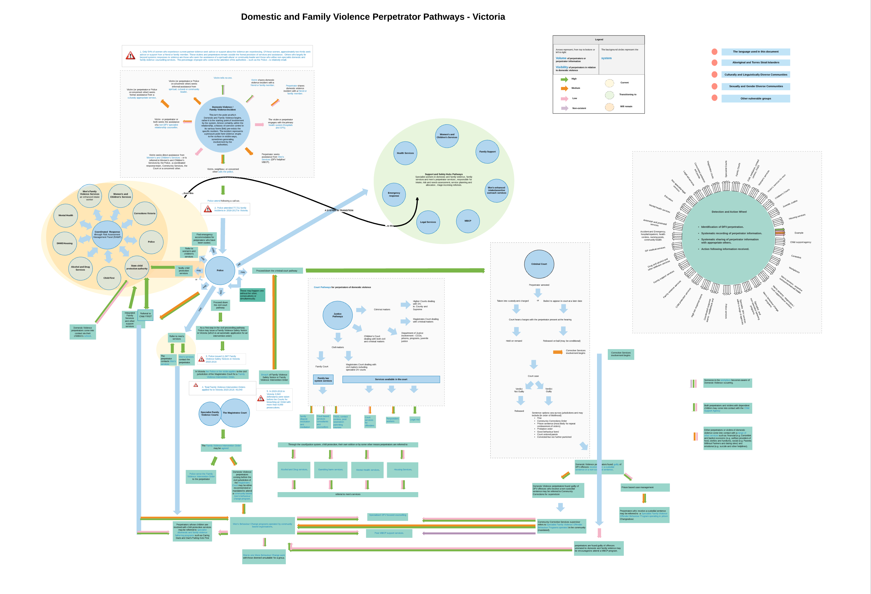

Slide 17
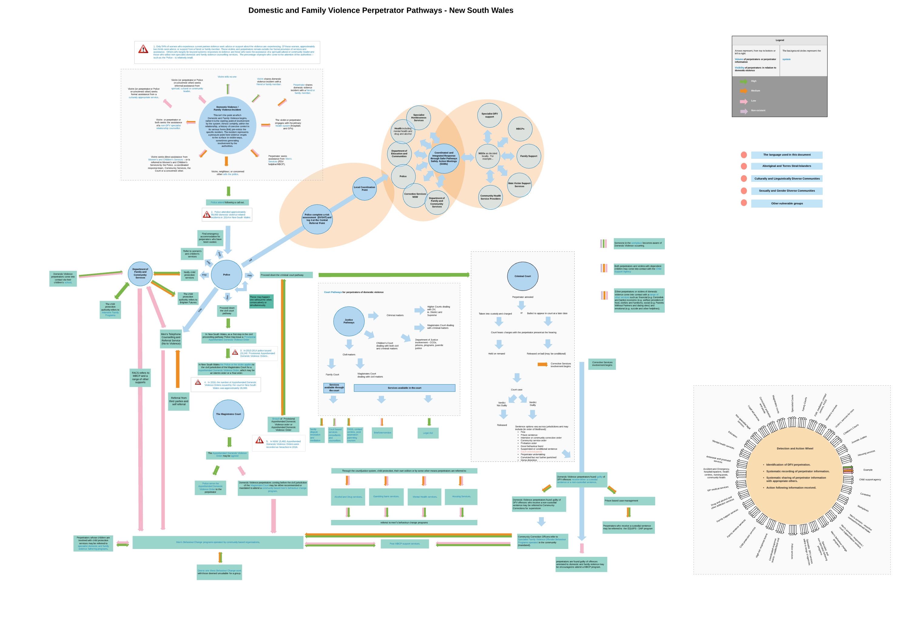
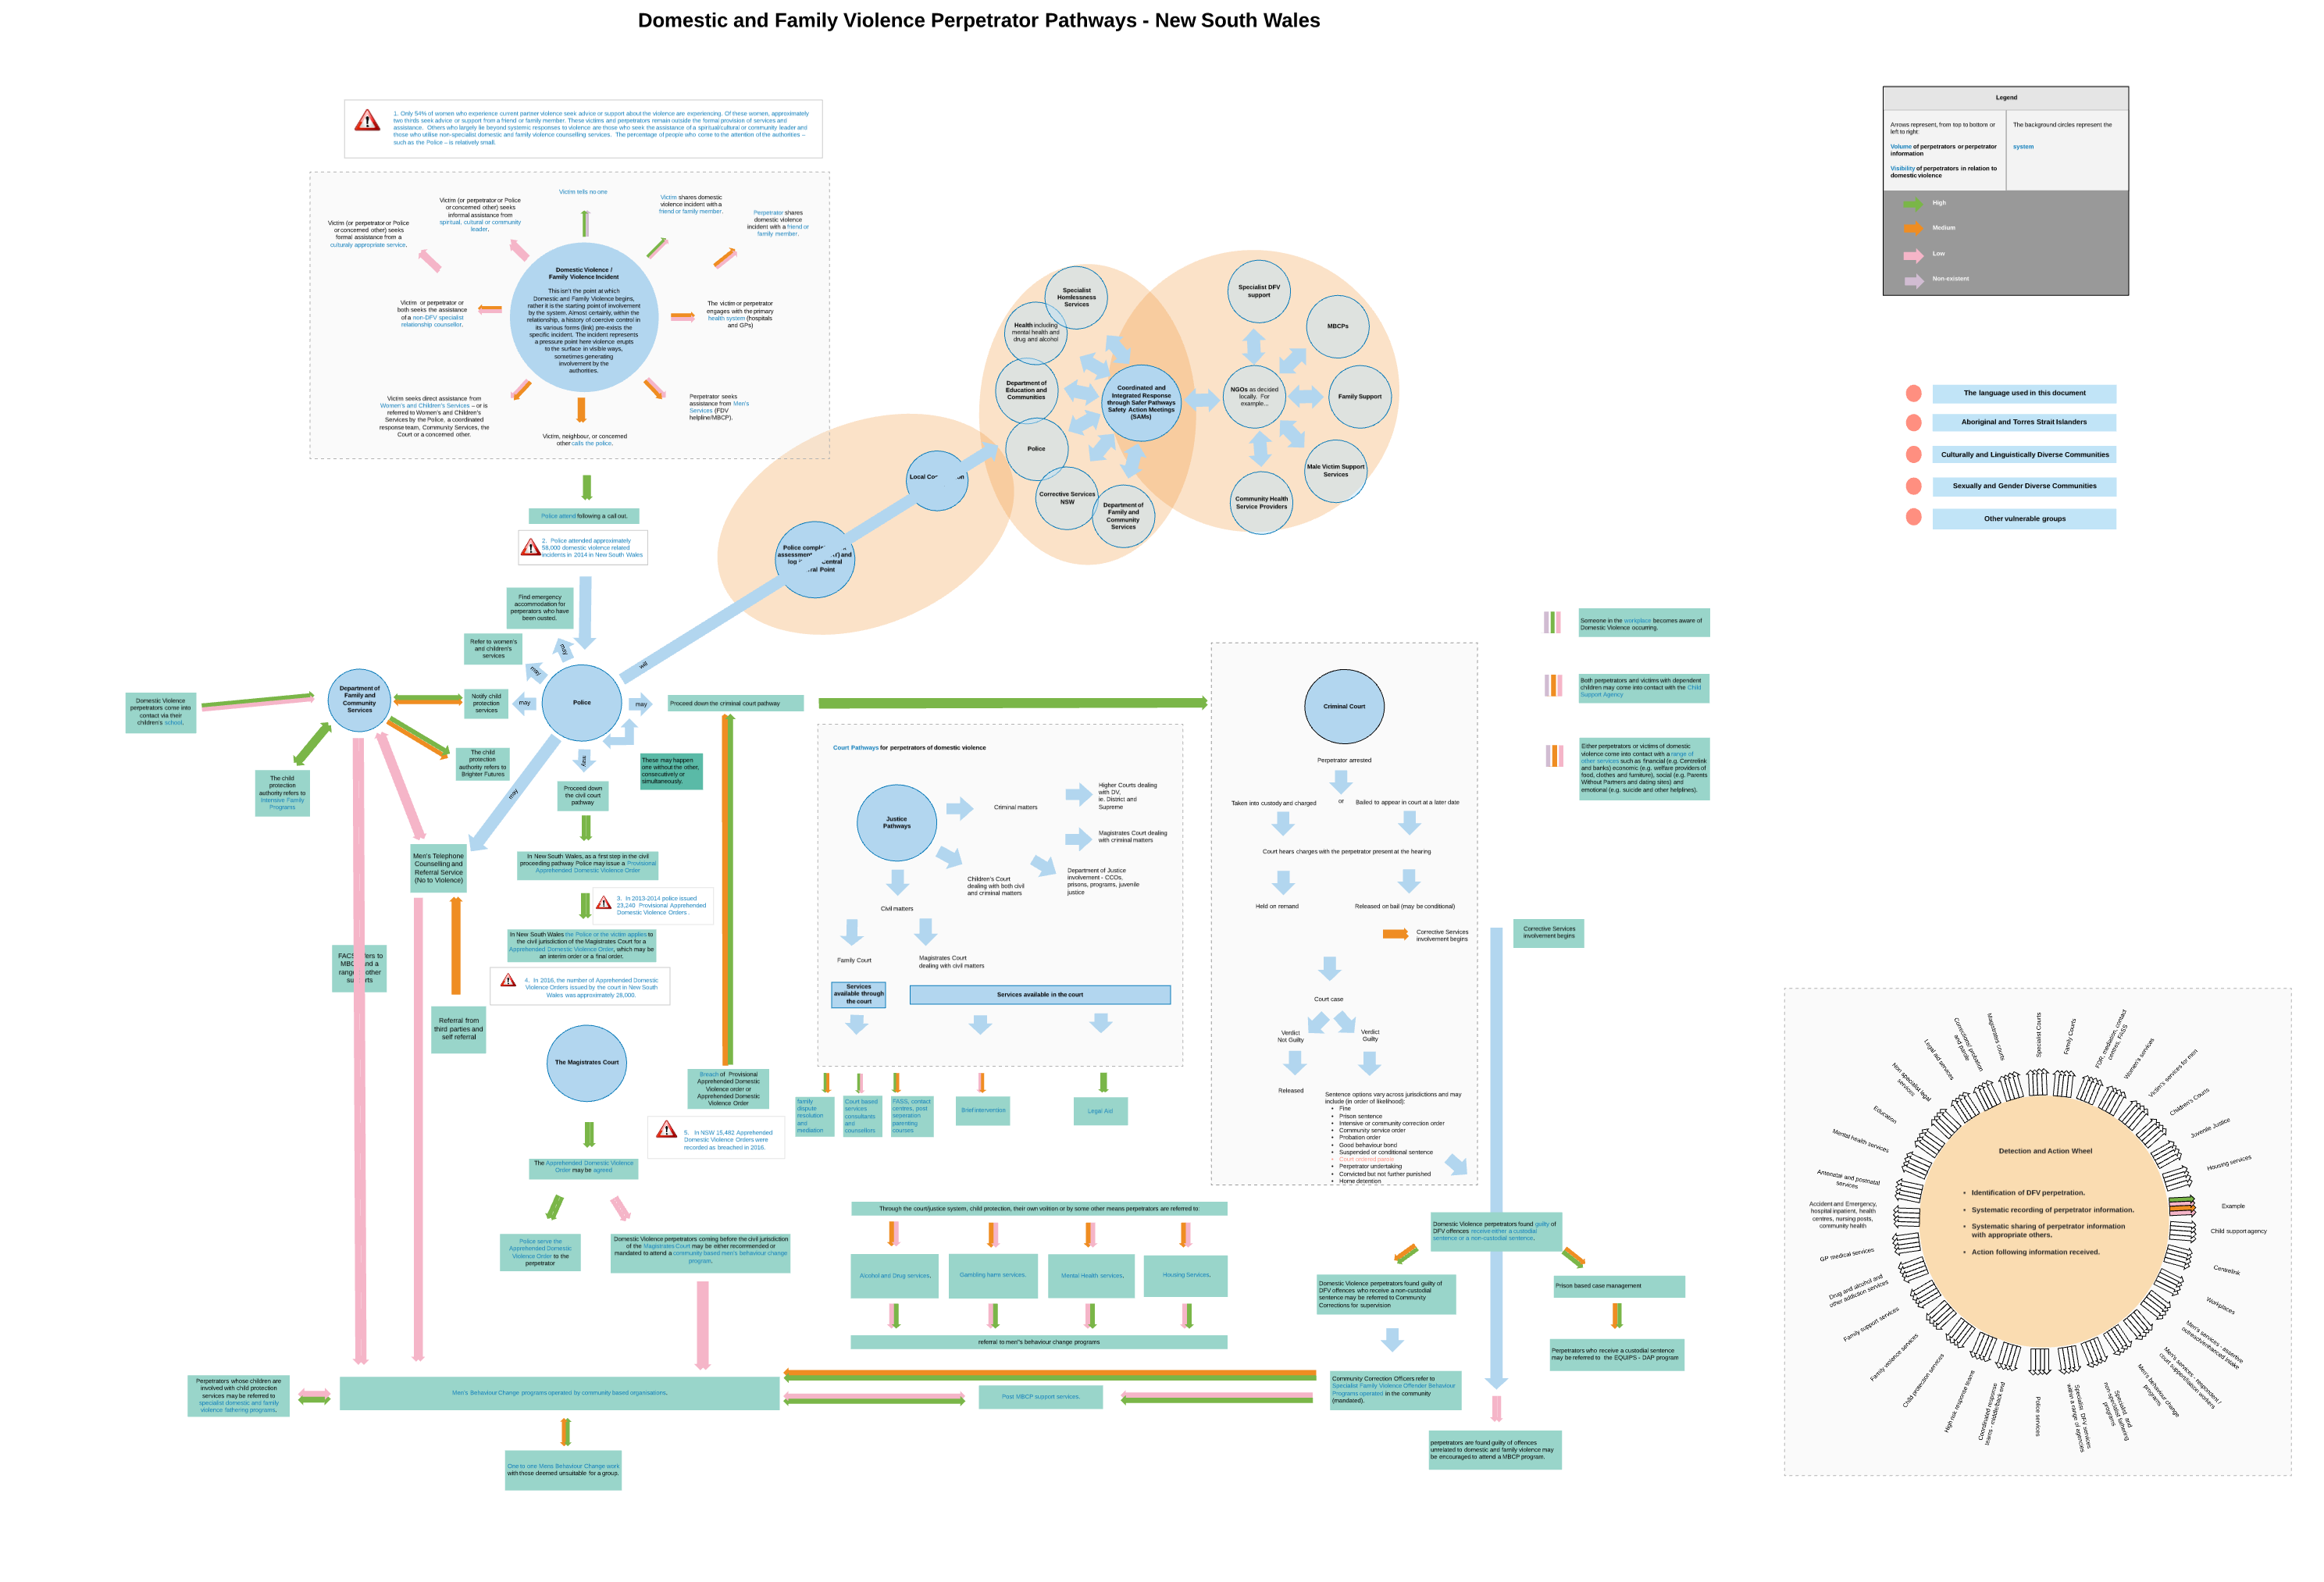

Slide 18
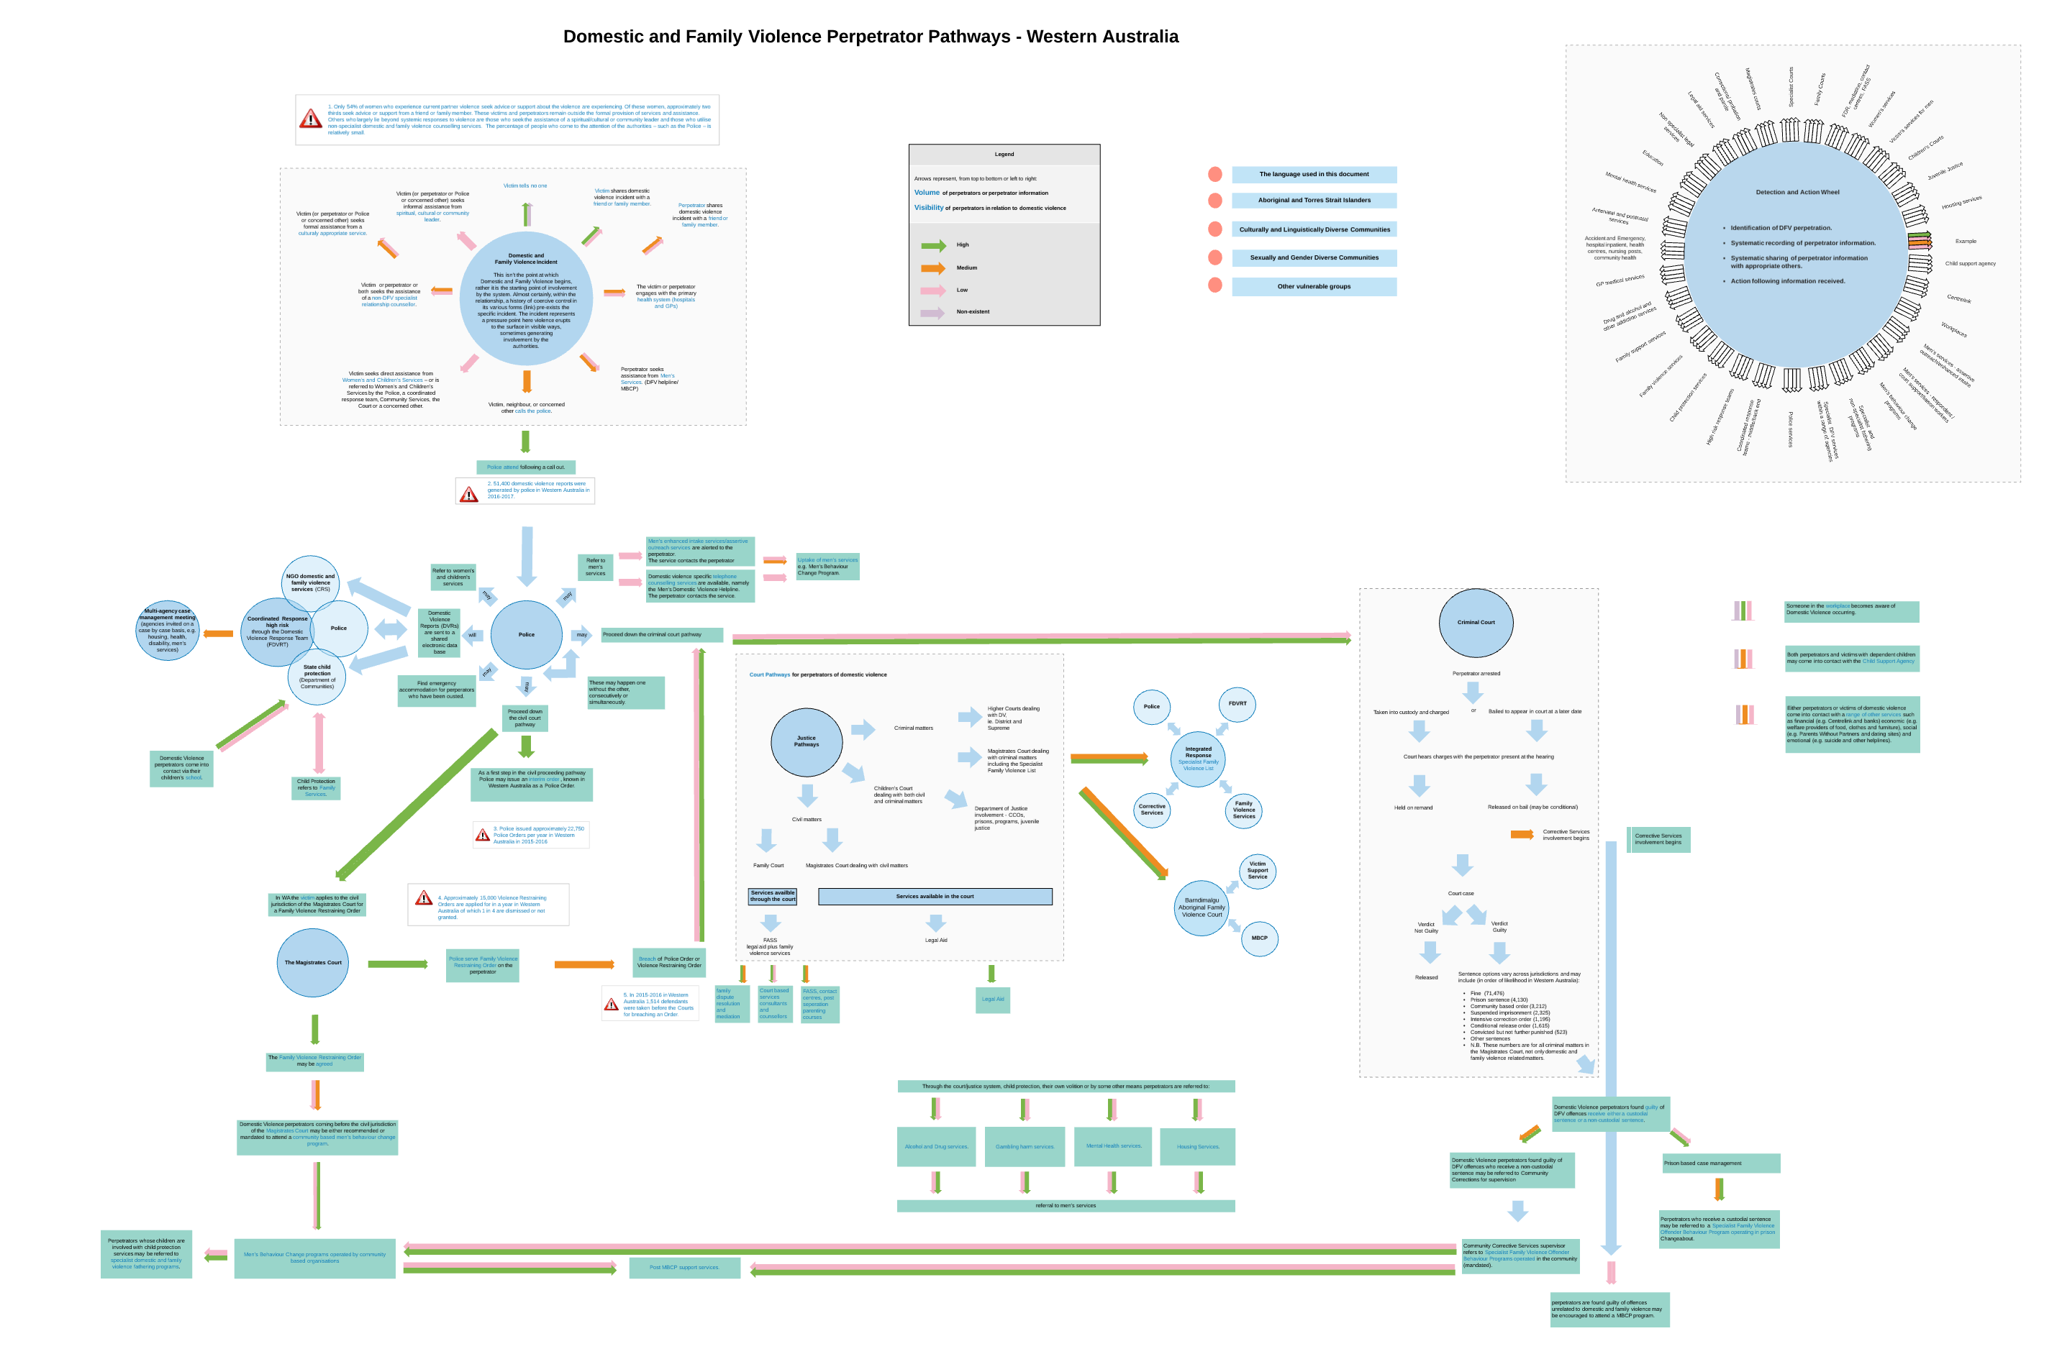

Slide 19
