Slide 1
Intervening with Fathers who Use Violence Safe and Together, Invisible Practices and Fathering Challenges.
Damian Green and Mark O’Hare

Slide 2
Background
FDV remains a major social problem in Australia, and the lives of children are profoundly affected by living with fear, abuse, and disabling effects of FDV.
Much of the FDV intervention in relation to children has focused on supporting separation, or focused on the woman and her mothering, completely ignoring the fathering role.
The impossibility of being a ‘bad partner and good dad.’

Slide 3
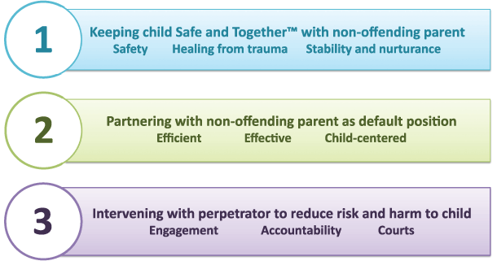
Safe and Together Model
Notes:
Safe and together is a model developed by David Mandel and Associates (Based in Connecticut, United States).
Safe and Together model is an approach to FDV cases involving children. It is a child-centred model that focuses on improving competencies like interviewing, documentation, and cross collaboration.
The name Safe and Together refers to the belief that children exposed to FDV perpetrator behaviour are ideally served when they can be kept “safe and together’ with the non-offending parent, usually their mother. It is based on the recognition that the non-offending parent is often playing an active, critical role in the safety, stability and nurturance of the children in the home. It is also premised on the fact that the relationship with the non-offending parent is often important to healing from the trauma of the violence and abuse.
Partnership with the non-offending F&DV survivor is the most effective and efficient way to promote the safety, permanency and well being of a child in a family with domestic violence.
A partnership with a non-offending domestic violence survivor needs to be based on a comprehensive assessment of her active efforts to promote the safety and well being of the children, as opposed to what is she doing to Fail to protect This means- what is mum doing on a daily basis to promote the safety and well being of the children despite the perpetrators pattern of coercive control. –For example- instead of mum failing to protect the children by not getting them to school on time each day, we can focus on the fact that she has managed to get that the children to school every day, even under the coercive practices of the perpetrator- taking the car on the Saturday and not returning/ or his pattern of offending just happens to be assaulting in the morning before school- or his behaviours keep the family up all night!
Child welfare agencies can improve outcomes for children and families by increasing their capacity to intervene with domestic violence perpetrators. –
this might seem obvious- that we should intervene with perpetrators, but not all perpetrators of FDV want to take 100% of responsibility for their behvaviour or want to in services to change their behvaiours. Crazy hey?? Unfortunately what happens though, is when the perpetrator is more challenging to engage, the attention has traditionally moved to mum to what she is not doing to protect the children.
A great way to explain the model is to show you a key practice tool which focuses on the perpetrators pattern of coercive control and the impact his behaviours have on family functioning. It guides the practitioner to also maintain a focus on mums strengths. .

Slide 4
Mapping Perpetrators’ Pattern
Some examples of the questions in the tool-
“Identify the perpetrators pattern of coercive control and actions taken to harm the children”
“The perpetrator’s behaviour pattern disrupted the family’s ecology in the following ways…”
“The adult survivor did______ to promote safety of the children in response to the perpetrator’s coercive control and actions to harm the children”
Notes:
First dot point- need to be specific here- can not write “history of DV”
Second dot point- this is moving away from incident based assessment. Examples- mum reports she lost her last two jobs due to dad harassing by phone or attending and threatening a male colleague or hers.
Third point- some examples of these may be that she sends the children to their room and tries to keep dad calm. Or maybe she has the dinner ready for him at 6pm because the time she didn’t he assaulted everybody in the family.

Slide 5
Invisible Practices Project
Child protection and family & domestic violence
Over 80 per cent of child protection cases coming to Child Protection and Family Support involve family and domestic violence.
Invisible Practices uses:
Action research
Community of Practice model
Safe and Together model of working with perpetrators who are also parenting children.
Notes:
Many interventions occur outside of specialist behviour change programs for men who are fathers and are still in contact or living with their children and partners. This project aims to research the current practice and knowledge; namely the skills required by child protection and family services’ workers to work with fathers who use violence and to document the skills. It’s intention is to provide a unique focus on research and workforce development. Through a collaboration between researchers, state child protection departments and NGOs in four participating states (NSW, QLD, VIC and WA) the project intends to shine a light on the ubiquitous but unacknowledged work of frontline practitioners in child protection and NGO family services intervening with fathers who use FDV.

Slide 6
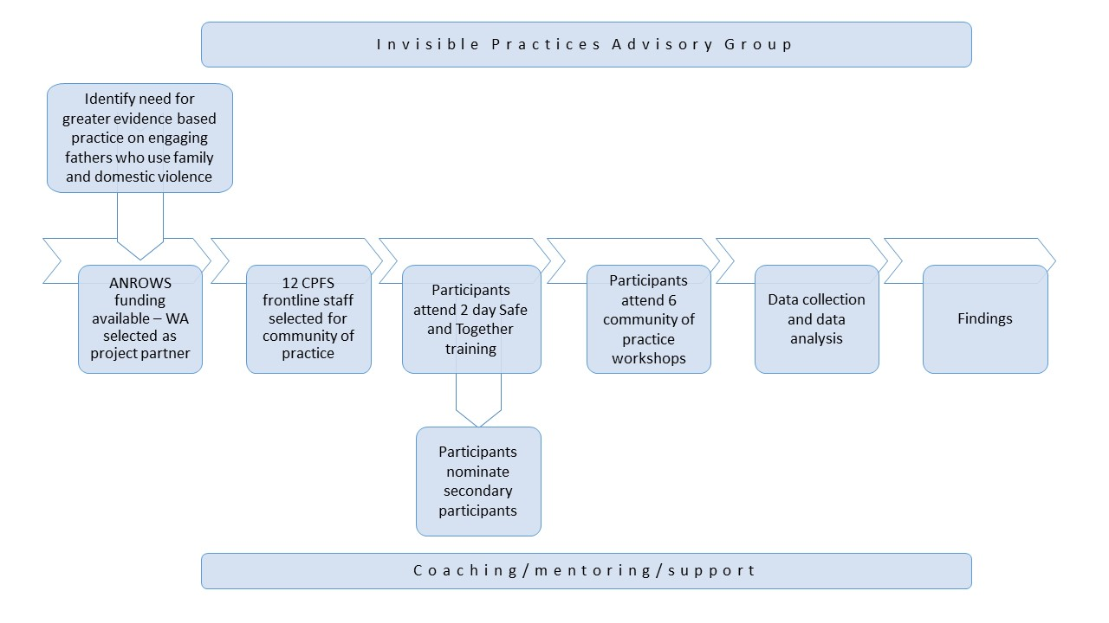
The Process

Slide 7
Research Questions
The questions the research team is exploring:
What do practitioners require from their organisations and/or other organisations to support them in working with fathers who use violence?
What evidence is there that the capacity building of workshops, supported by coaching and supervision from the US-based Safe and Together Institute, provides increased experiences of safety and support for practitioners?

Slide 8
Western Australian experience
What is a Community of Practice?
WA is the only jurisdiction where all community of practice participants are departmental staff
Twelve participants from 11 districts
Combination of metro and regional staff
Mix of child protection workers, team leaders and Aboriginal Practice Leaders
Forums:
Meet monthly to share learnings and support the journey in working with
perpetrators
Secondary participants:
Identified by community of practice participants as a way of sharing practices
within districts
Notes:
Districts involved:
Perth
Cannington
Joondalup
Fremantle
SDPU/Prisons
South West
Pilbara
Murchison
West Kimberley
Great Southern
Participants meet monthly and link with facilitator Kyle Pinto from the Safe and Together Institute to share learnings

Slide 9
Early Findings
What the research team has discovered:
A small change in focus makes a big difference in practice and outcomes
Increase in trust and rapport with non-offending parent
Perpetrators are being held more accountable for their behaviours
The Department of Communities as an organisation has been very receptive and supportive of the model.
Notes:
By focussing on the perpetrators patterns of behaviours, participants in the project have reported increased engagement from the perpetrator and better rapport and working relationships with the non-offending parent. In practice this has meant that the non-offending parent has often been more open to disclosing abuse, including sabotaging behaviours, from her partner. In other words, the non-offending parent is trusting the child protection worker more!
It is important to change the language from something like “we see you let your partner back in to the house over the weekend and put your children at risk, we therefore need to…” to something more like “It looks like your partner is trying to sabotage your efforts to protect your children. We would like you to know that we have/will be meeting with your partner to discuss his behaviours”. What is this impact of this change in language?
Allows the non-offending parent to recognise services are on her side; places the responsibility onto the perpetrator; informs the non-offending parent that the perpetrator is the person that needs to change his behaviours
Noticeable changes in the information that has been seen in documentation- There have been increases in attempts to contact the perpetrator. More prison visits with perpetrators have been reported by participants. More detailed information on the perpetrator in documentation.
Language has changed in the offices- more focus on identifying what the partner is doing to protect her children rather than failing to protect. Also, it has been reported that a refocus onto the perpetrators specific patterns of behaviours which may be impacting on the day to day family functioning is happening in offices since the project started.
More emphasis on engaging men in fathering practices and supporting the mother in her parenting.
CoPs have reported a very positive reception and support from the Dept- from field officer to Director level which has definitely contributed to the positive outcomes so far.

Slide 10
Fathering Challenges Project Aim
There is limited research on the fathering practices of men who use violence, and interventions to address this cohort.
The aim of this project is to improve the parenting experience of children whose fathers have used family and domestic violence (FDV), and fill this significant gap.

Slide 11
Research Questions
Q1) How, and under what circumstances are father who use violence parenting?
Q2) What are the key fathering issues that need to be addressed within MBC, Aboriginal and fathering programs?
Q3) How do MBC, Aboriginal Programs and Fathering programs currently address the issue of fathering in the context of family violence?

Slide 12
The Research Team
The University of Melbourne, University of South Australia, and Curtin University.
23 NGOs, and Governments from three states across three program areas: (i) MBC; (ii) Culturally specific programs for Indigenous men who have perpetrated FDV. (iii) Fathering programs that address child abuse.
5 Chief Investigators
More than 10 other research associates, and research assistants.

Slide 13
Studies
Evidence Review 1
Study 1: D/FV and Fathering Program Audit.
Evidence Synthesis 1: Aboriginal Specific Programs.
Evidence Synthesis 2: Fathering behaviours of FWUV.
Study 2: Profiles of FWUV – Administrative Date Analysis.
Study 3: Survey of FWUV attending MBC, Indigenous and Fathering Programs.
Study 4: Interviews with Women.
Young People’s Perspectives.

Slide 14
Evidence Synthesis 3
Addressing RQ 3 and identifying best practices for working with fathers who use violence.
Two parallel streams of evidence have been drawn upon: i) current practice which addresses fathering and abuse.
ii)parenting issues and challenged for fathers who use violence married along with feedback from stakeholder workshops.

Slide 15
Findings
RQ1) How, and under what circumstances are father who use violence parenting?
Fathering practices in the context of DV were conceptualised through several subthemes, including emotional care and involvement, developmentally appropriate expectations, fathering through fear, neglect and familial context.
Many of these themes were also identified in the interviews with women who were partners/ former partners of men who perpetrate FDV.

Slide 16
Findings
RQ2) What are the key fathering issues that need to be addressed within MBC, Aboriginal and fathering programs?
The program review found there are a limited number of FDV programs that address men’s fathering (very limited in Australia).
To add to…

Slide 17
Findings
Programs that do address fathering of MWUV can be separated into four approaches: 1) Specific MBCPs that use children as a motivation for change but include very little content on fathering; 2) two separate programs: MBC and Fathering. These consist of a MBCP followed by (or concurrent to) a Fathering program for men who have been violent; 3) an MBCP that contains embedded content on fathering; and 4) holistic, contextualised, culturally-embedded programs such as those developed by Indigenous communities throughout the world.

Slide 18
Conclusions
There has been a gap is research, policy and practice in addressing the needs of FWUV.
Fathering practices of FWUV needs to be understood more broadly than the exposure of children to physical and verbal violence.
Programs and services currently being utilised by fathers who use violence often do not provide interventions for their clients as both fathers and men who use violence.

Slide 19
Conclusions
Only a limited number of MBCPs include components on fathering.
Mainstream parenting programs are unable to address fathering by MWUV.
Fathering programs are currently addressing fathering within the context of FDV at a competent level.

Slide 20
Fathering Challenges - Practice Implications
The development of a Practice Continuum is in its final stages.
It will provide:
A means to conceptualise issues affecting all Program types.
Used to address a particular client cohort which is serviced by multiple program types.
A means of synthesising multiple strands of the Fathering Challenges research into a single, implementable framework.

Slide 21
Future Opportunities
Further implementation and teaching the Safe and Together Model across other government departments and services.
Development of best practice and program logic for programs intervening with fathers who use violence.
Communities of Practice and systematic responses.

Slide 22
Any Questions?

